Slide 1
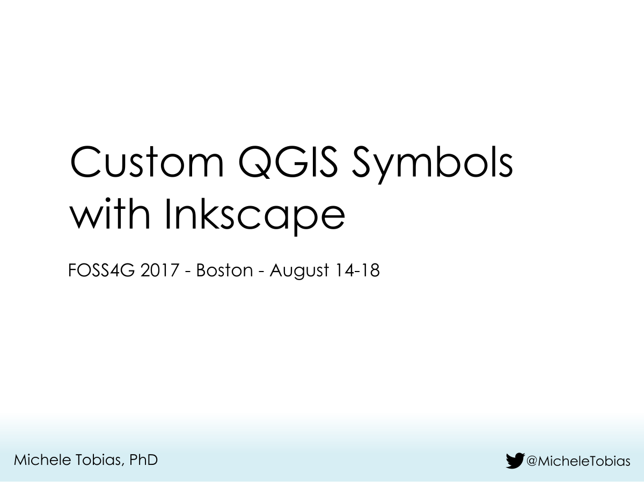

Slide 2
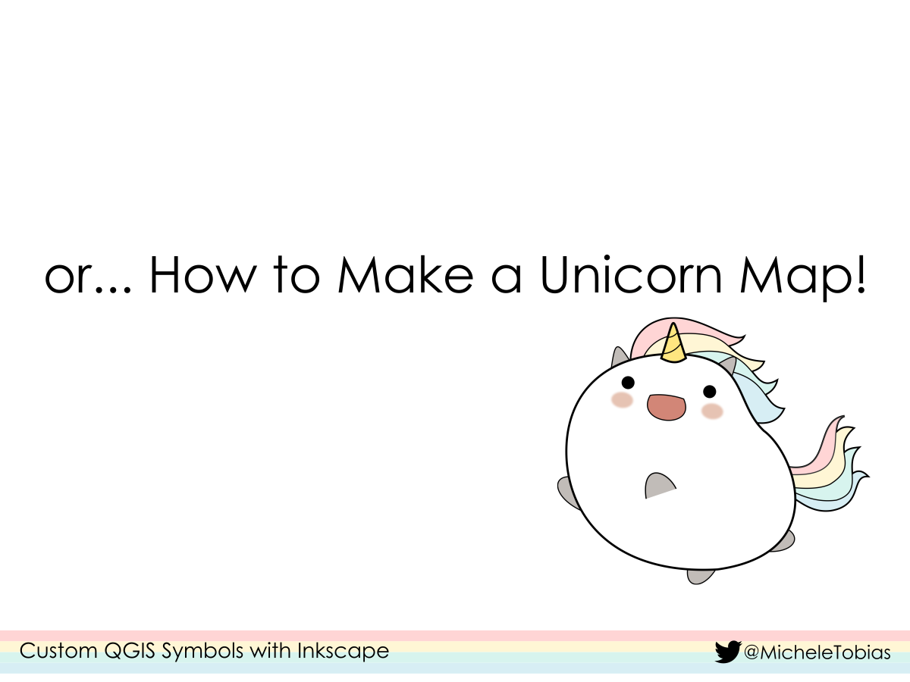

Slide 4
Maybe…
All your maps look the same & you’re ready for something different.
You need a specific icon, but it’s not in QGIS.
You see other maps and wonder where the cartographer got that cool/clever/hipster element.

Slide 5
let’s look at one option:
Inkscape

Slide 6
What is Inkscape?

Slide 7
How does Inkscape work with QGIS?

Slide 8
Ok, enough talking! Let’s make some stuff in Inkscape!

